Slide 1
PA2312044010009 _CT3_Reamiya Reddy
File created on: 5/12/2024 5:39:49 PM

Slide 2
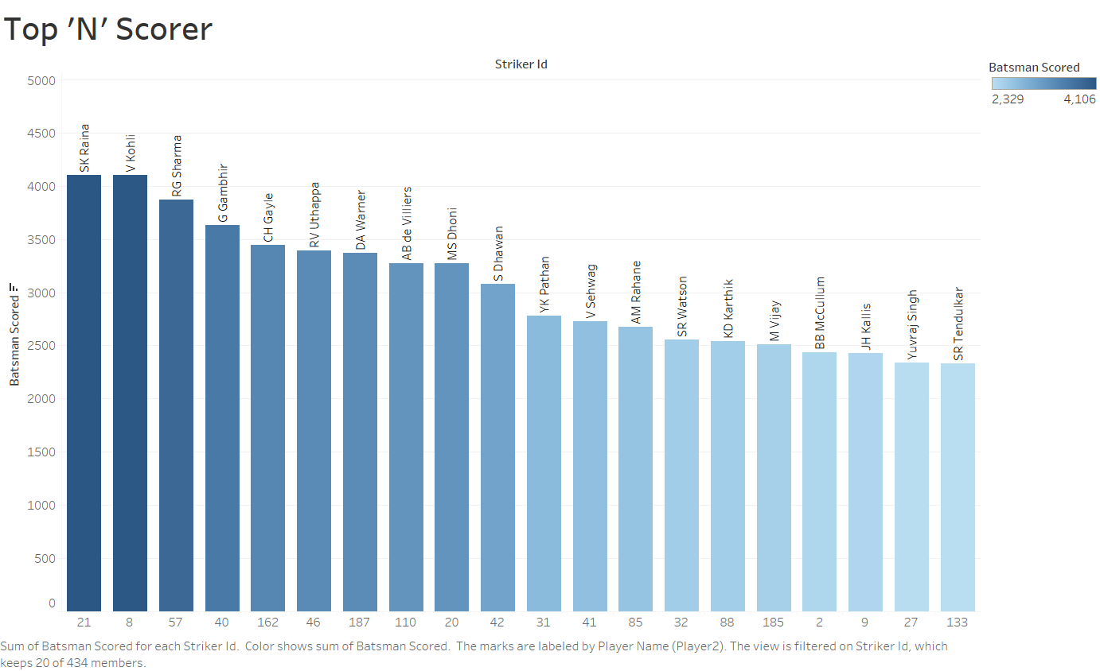

Slide 3
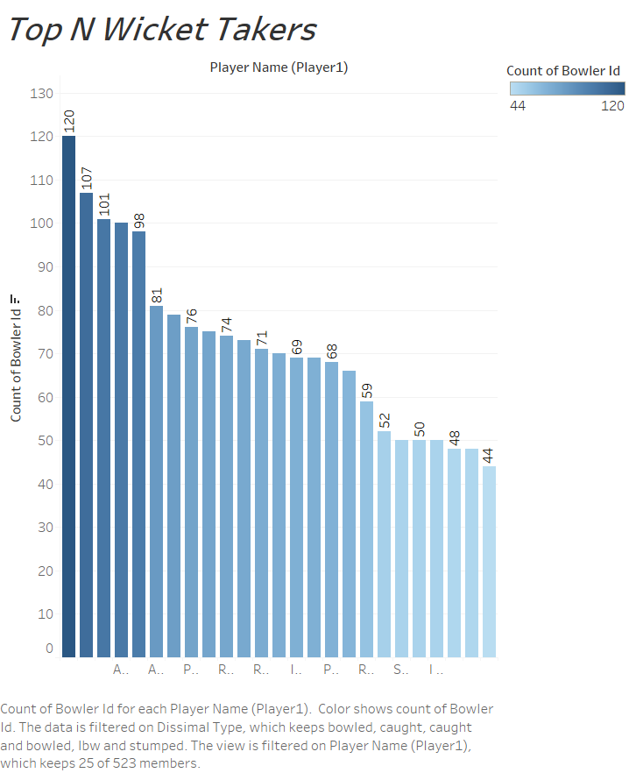

Slide 4
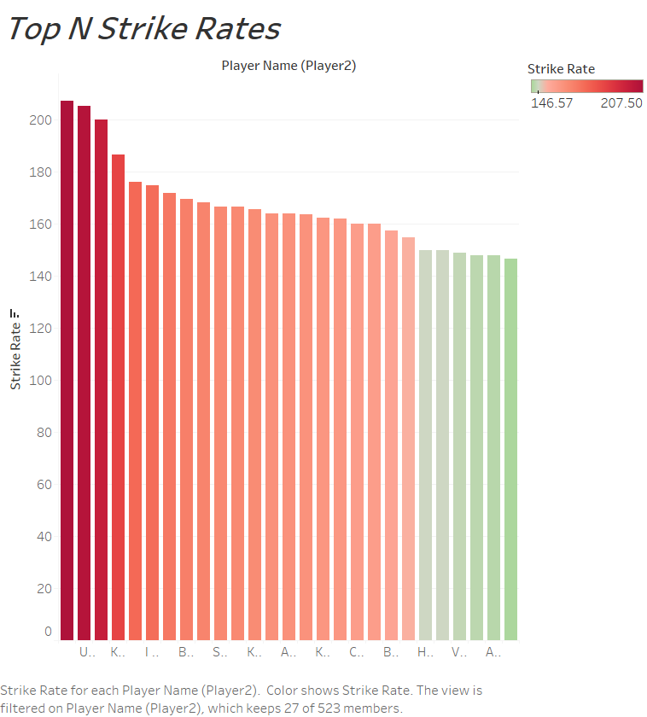

Slide 5
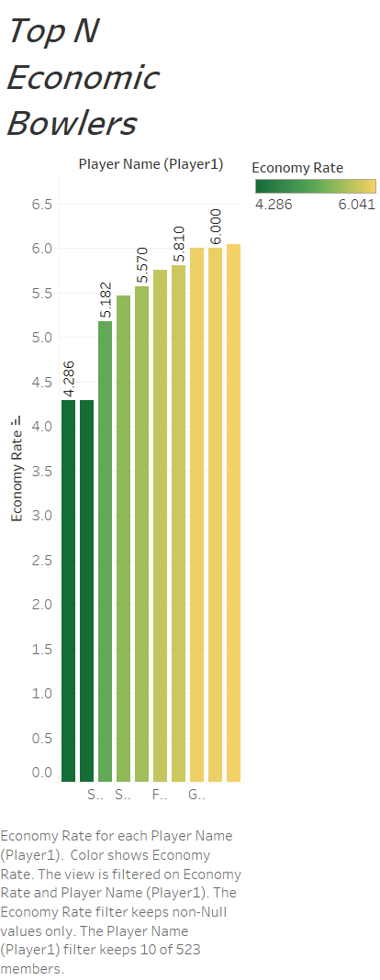

Slide 6
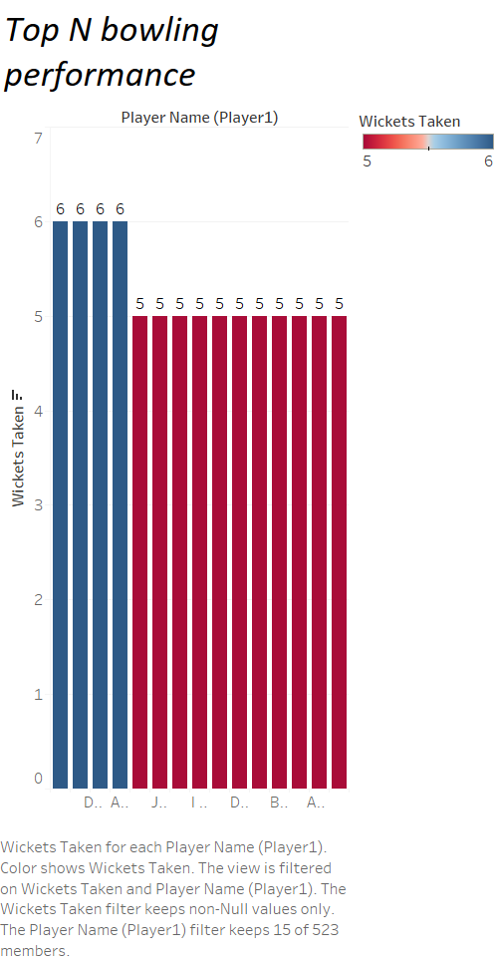

Slide 7
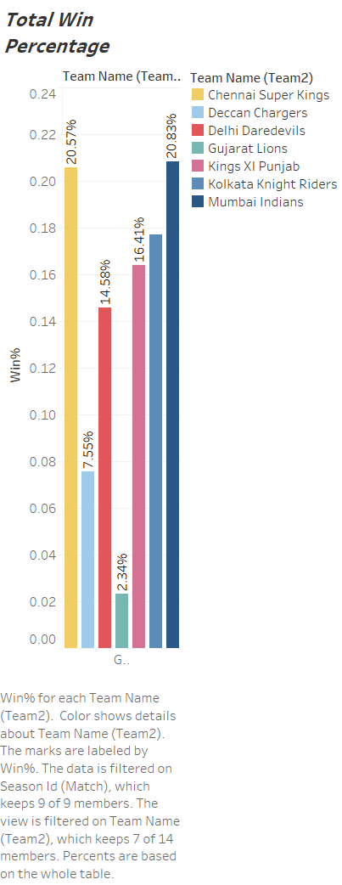

Slide 8
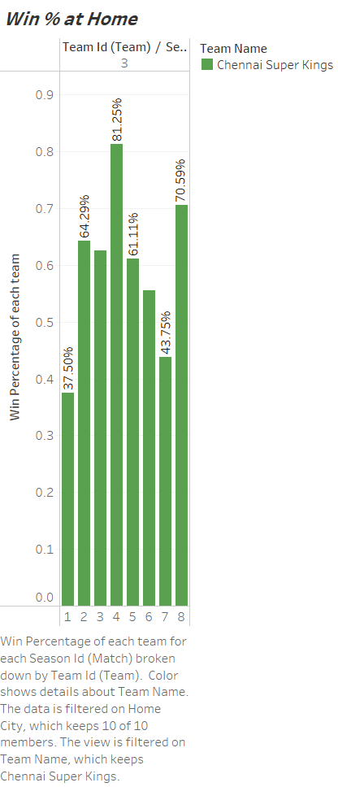

Slide 9
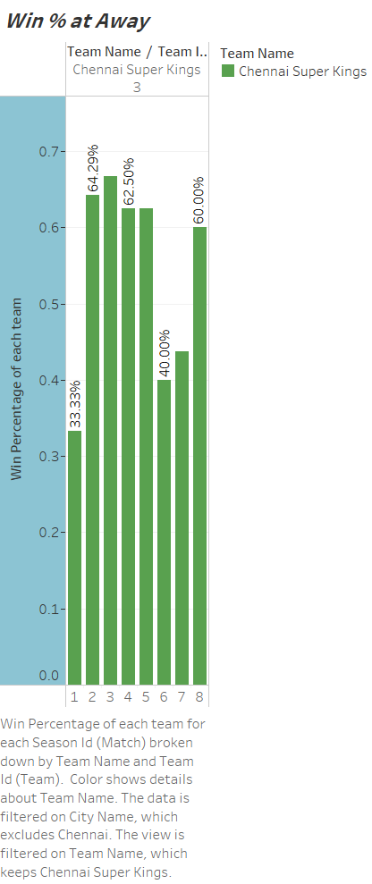

Slide 10
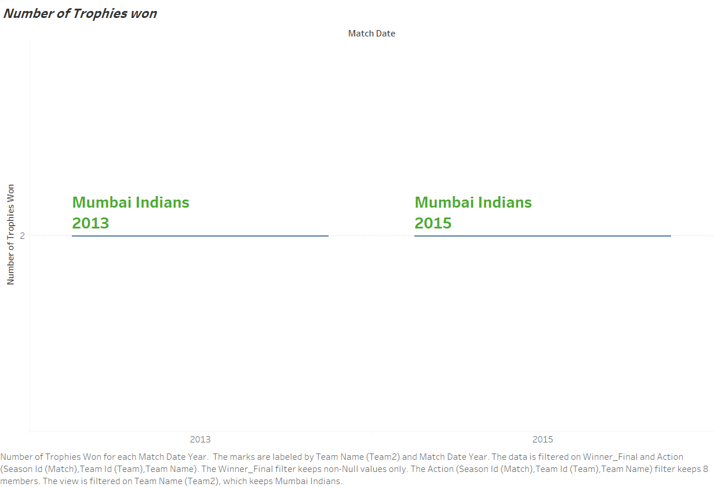

Slide 11
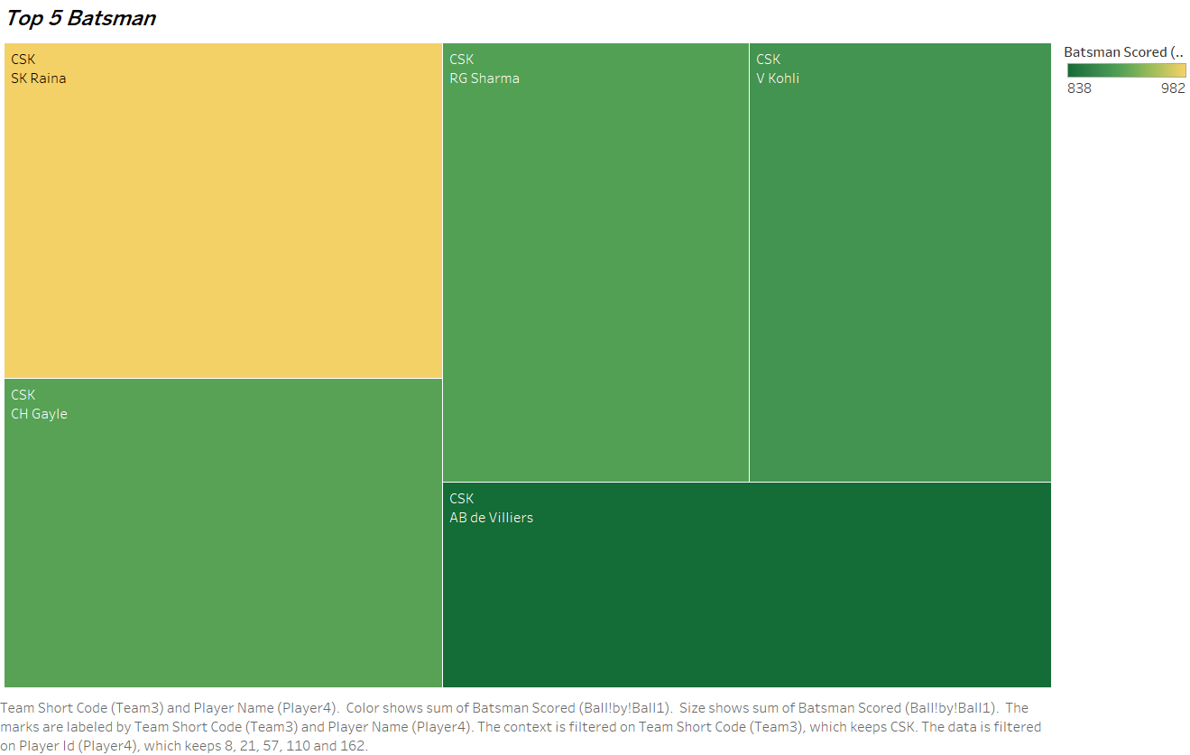

Slide 12
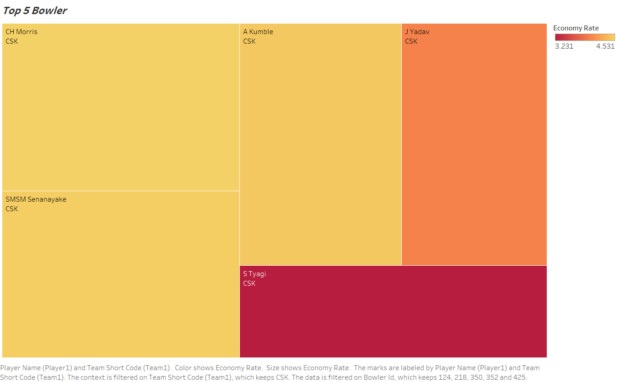

Slide 13
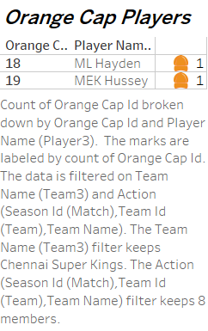

Slide 14
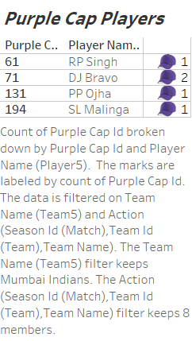

Slide 15
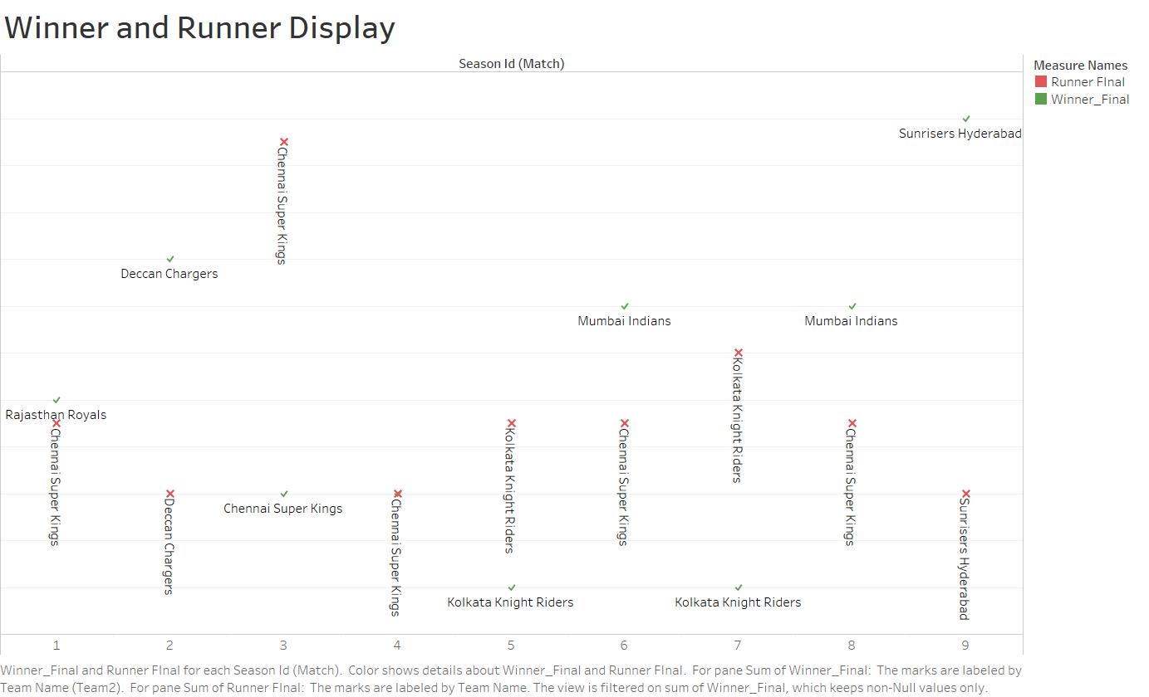

Slide 16
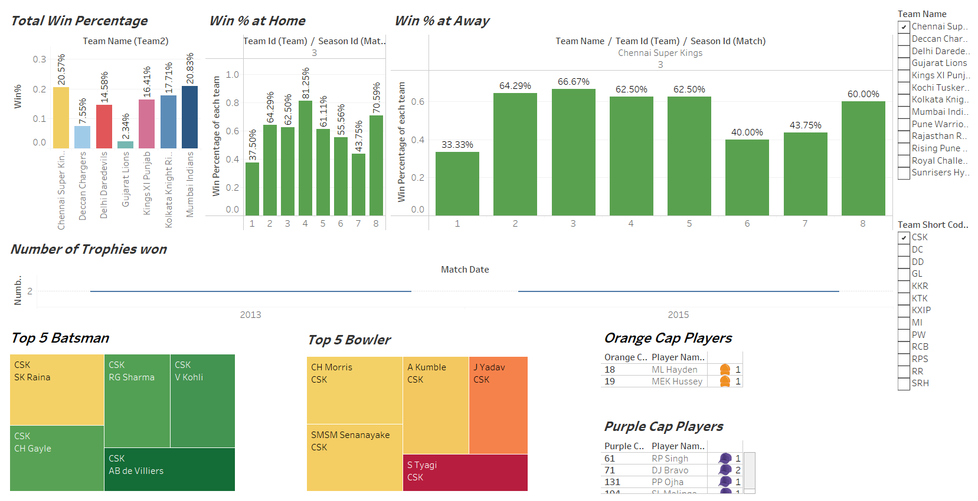

Slide 17
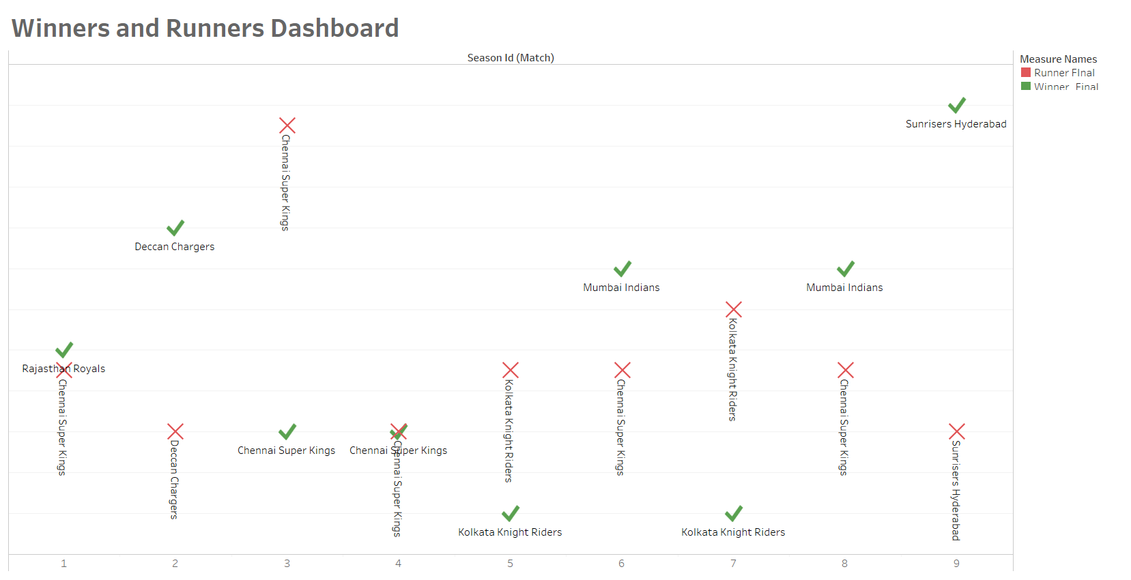

Slide 18
Dashboard link
https://public.tableau.com/views/PA231204401009ramiyareddyProject/Dashboard1?:language=en-US&:sid=&:display_count=n&:origin=viz_share_link
https://public.tableau.com/views/PA231204401009ramiyareddyProject_tabluae/Dashboard2?:language=en-US&publish=yes&:sid=&:display_count=n&:origin=viz_share_link
github:

